Slide 1


Cover Page
Team 55900 Plans

Slide 2
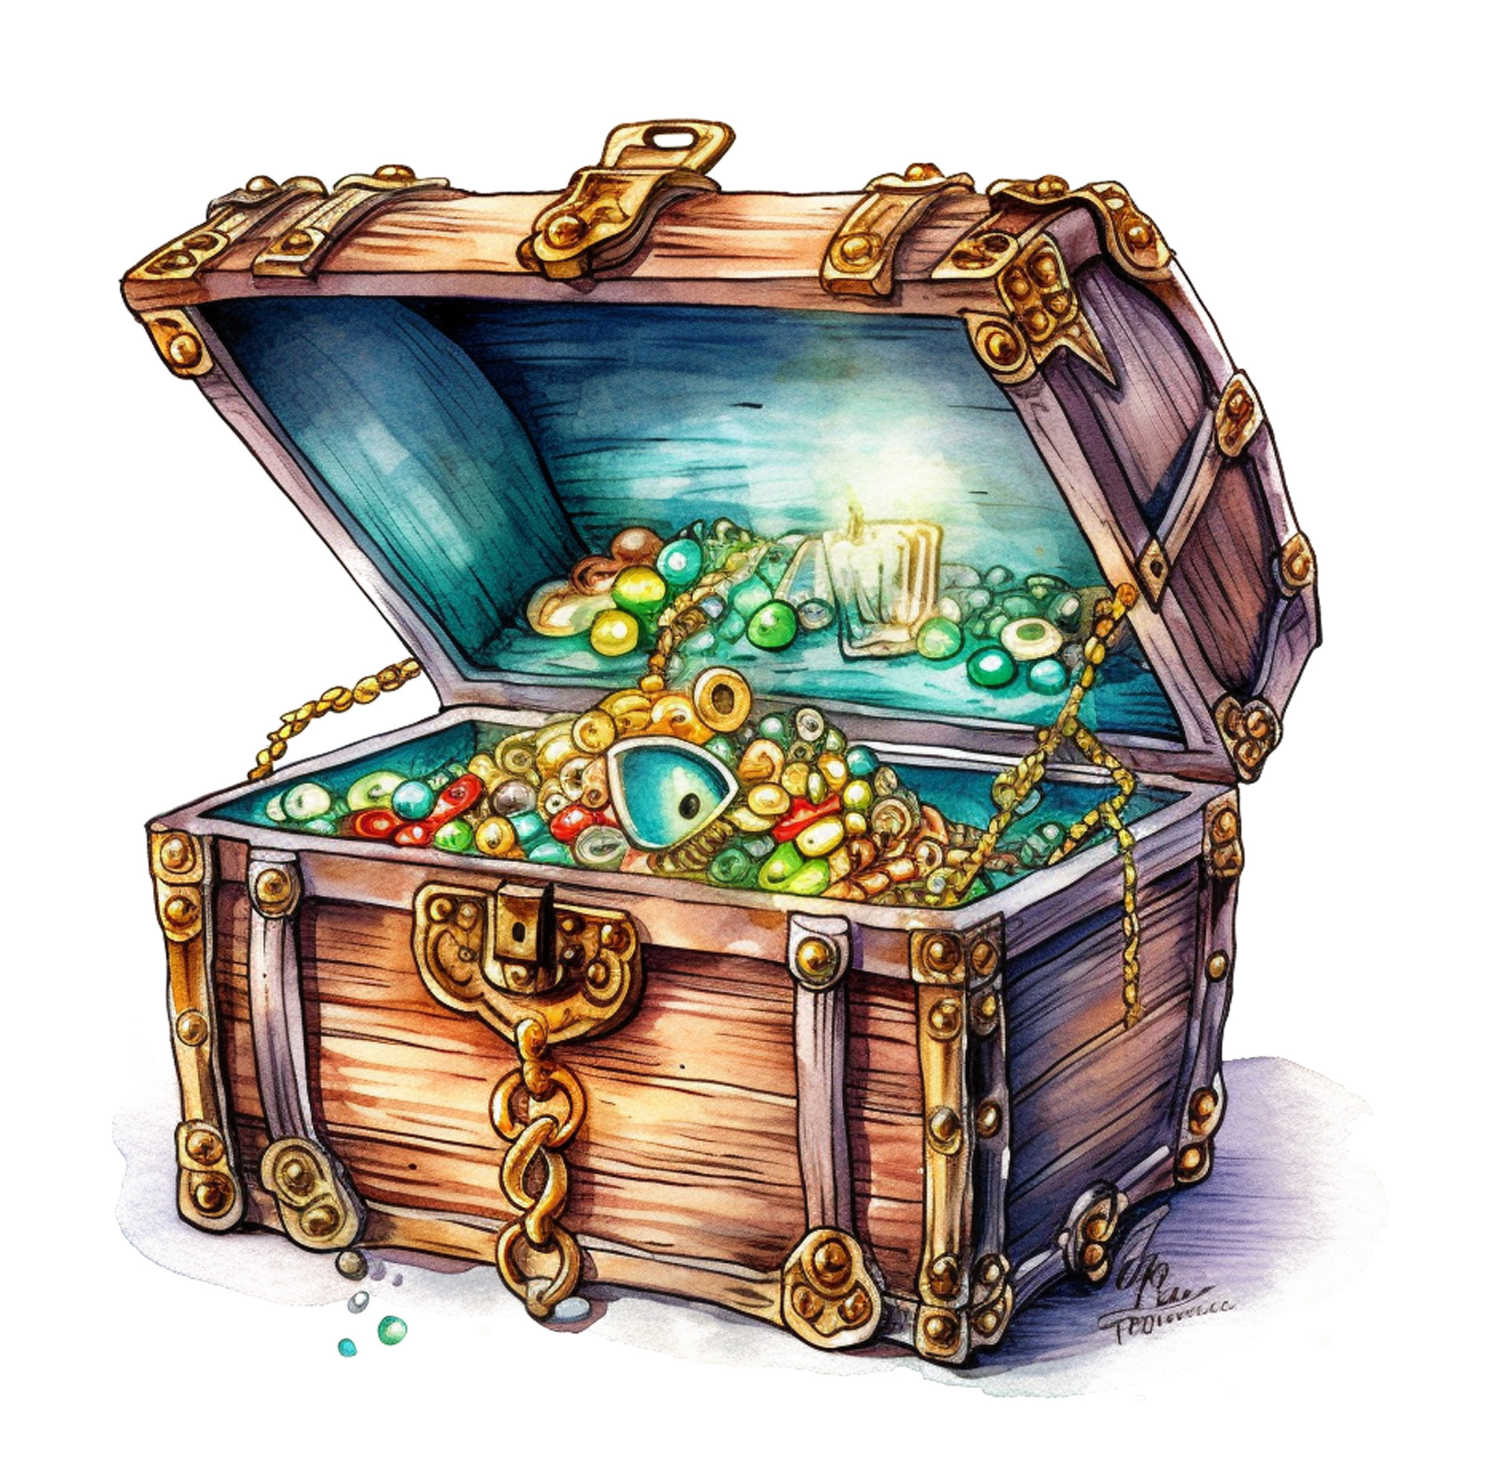
Angler Artifacts
. 7 clicks to “raise the flag” successfully
. On the top hit, on the bottom pull out on the tire
. Starts from RED
. Ends at BLUE
. Shovel lifter on the back
. Whacker on front
.Finished

Slide 3
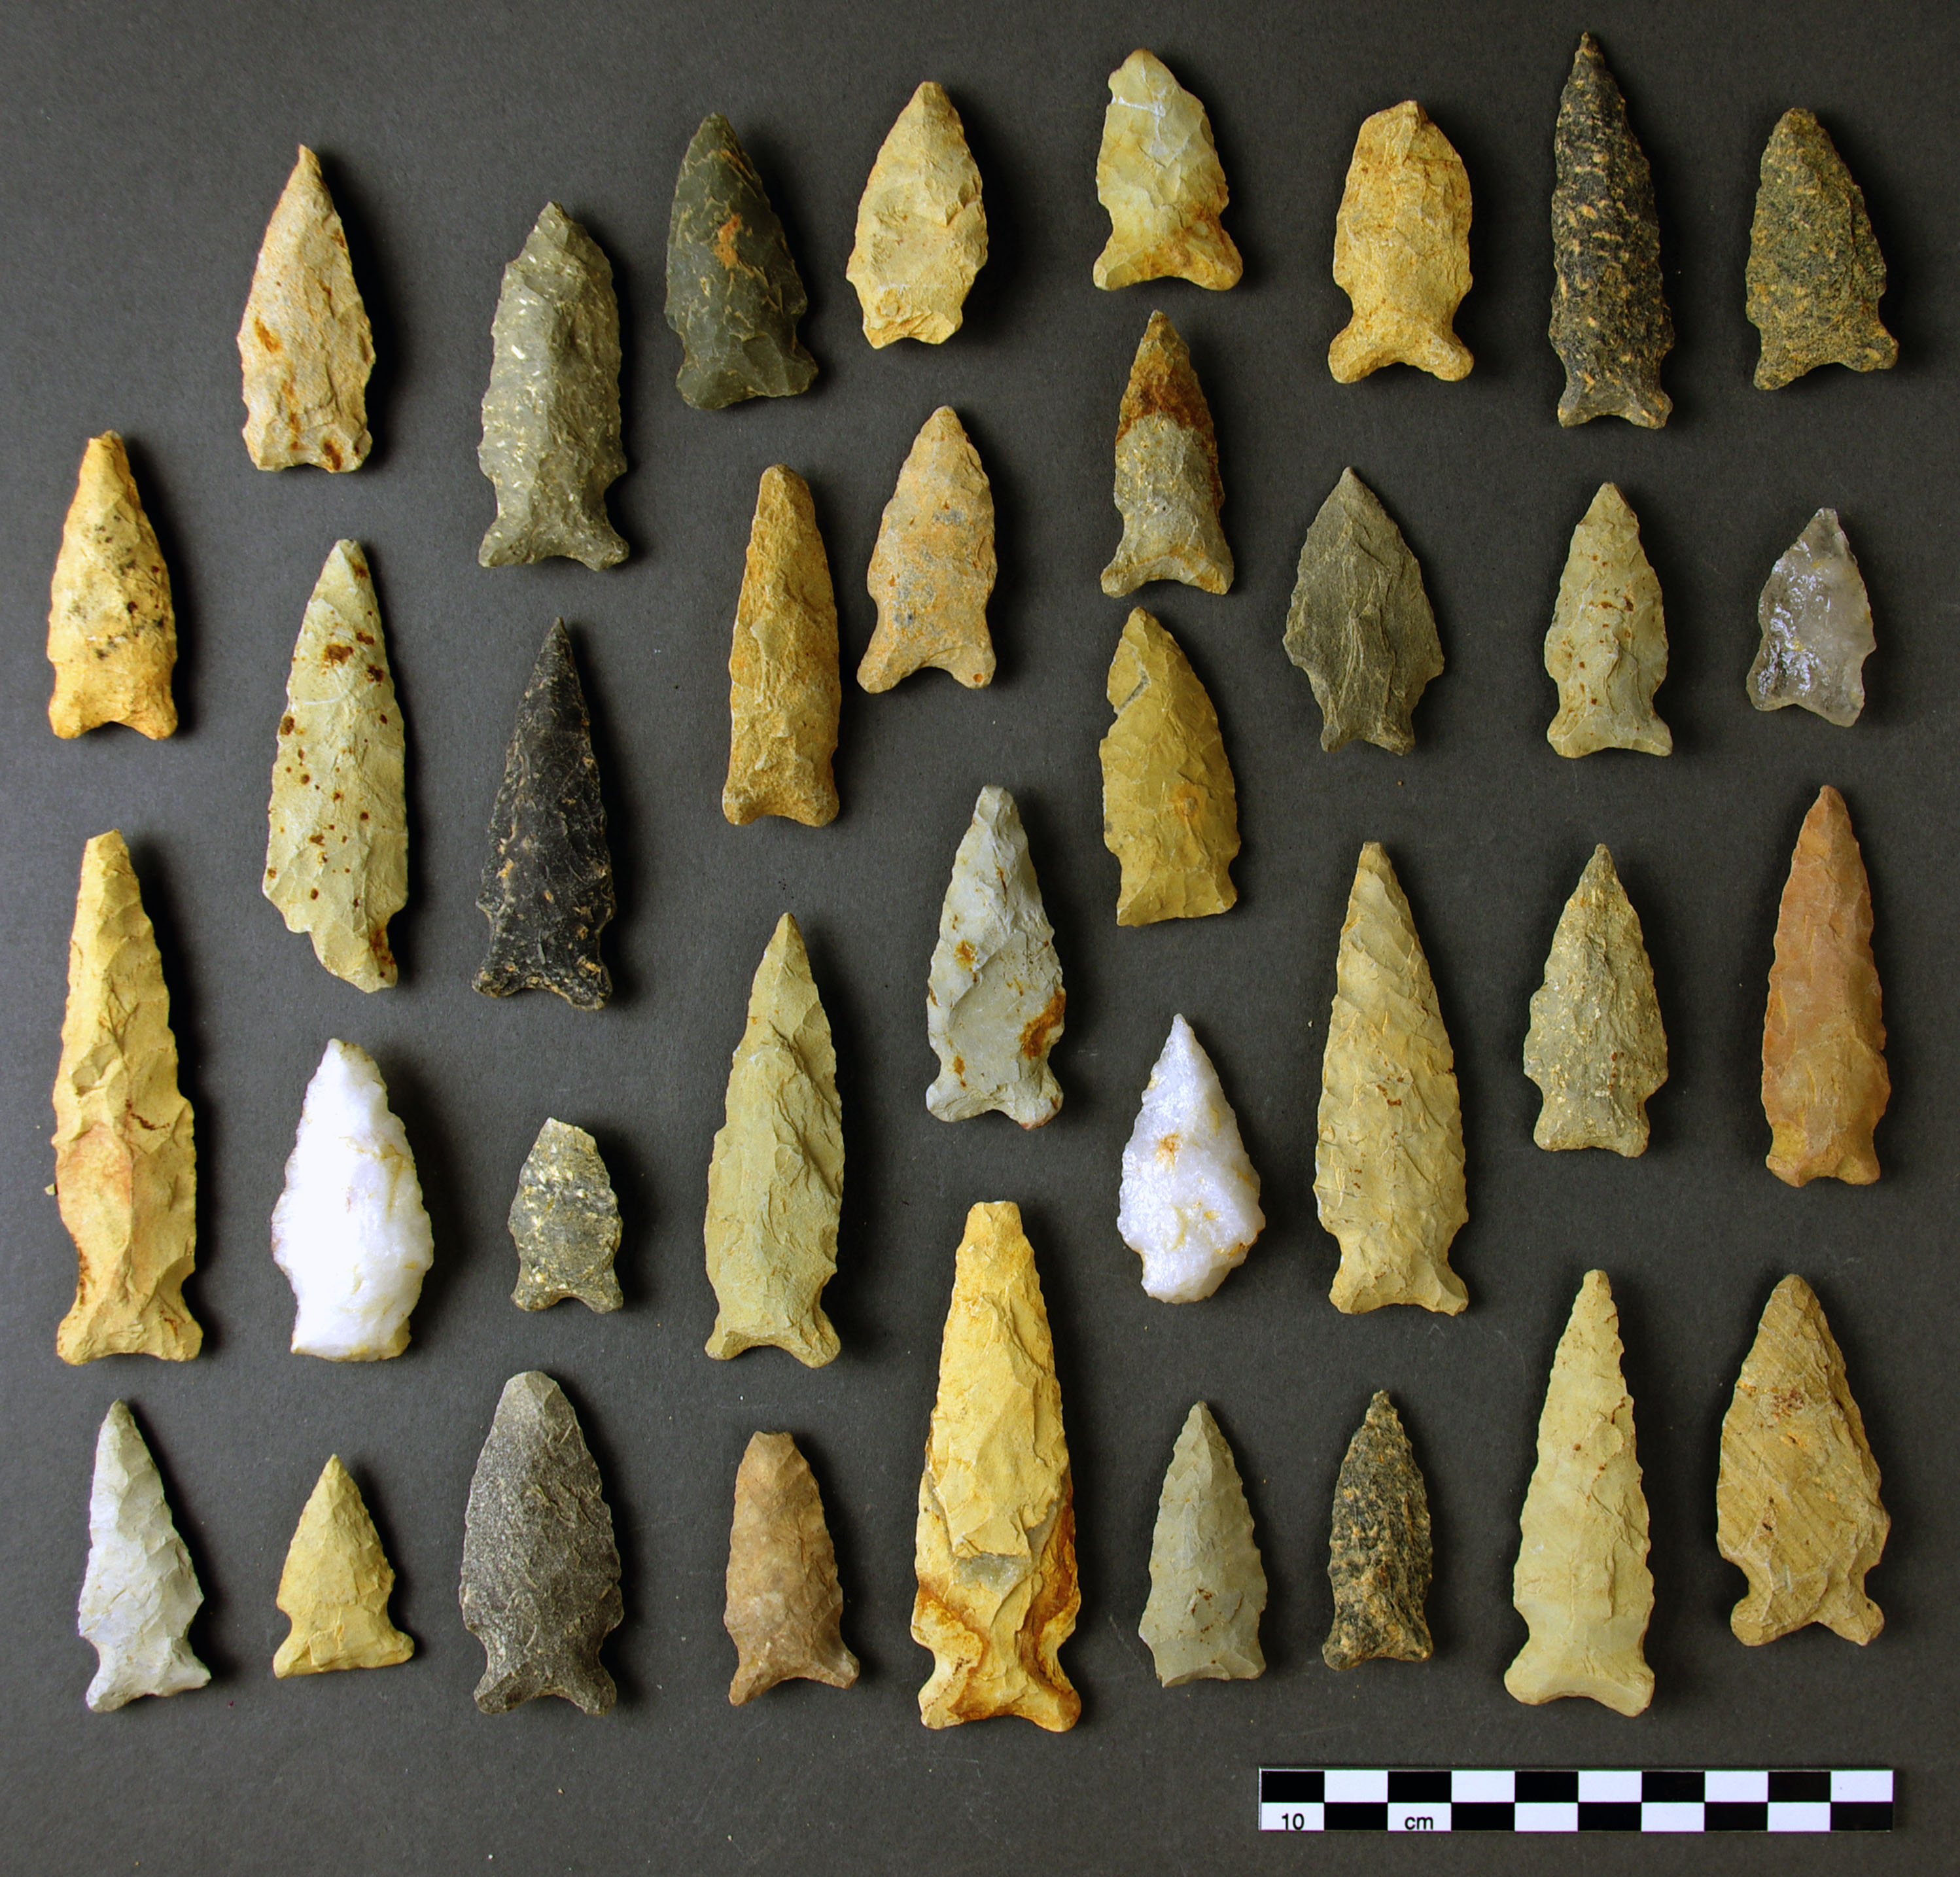
Mineshaft Explorer
. Start at RED
. Ends at BLUE
. Shovel lifter on back
. Whacker on front
.Finished

Slide 4

Surface Brushing
. Sweep back and forth
. Back up
. Turn
. Go forward back to home base colored RED
. Learn what degrees is
. Whacker
. Finished

Slide 5

. Easier not to use the RED lever to raise . You can’t have the shovel lifter to close to the ground . Shovel lifting on back . Whacker on front . Finished
Statue Rebuild

Slide 6
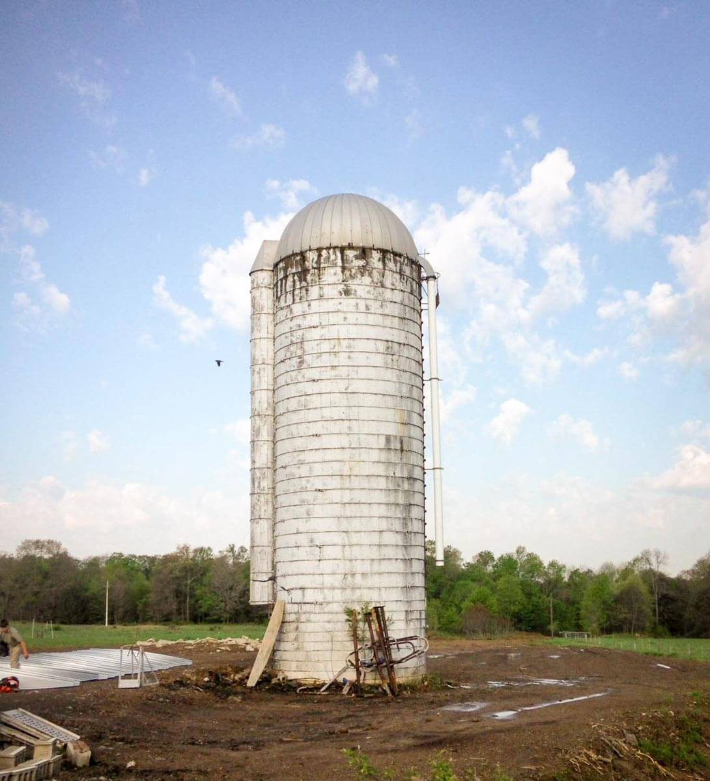
Silo
. Start from BLUE Base
. Hit the lever 10 times to make sure it works
. The wheel whacker
. Finished

Slide 7

Heavy Lifting
. Start from BLUE base
. Wheel whacker with out wheel
. Finished

Slide 8

. Start from BLUE base . Hit tire on the bottom of FORGE . Sweep past WHO LIVED HERE? . No attachment except side whacker . Finished
Who Lived Here? And Forge

Slide 9

Salvage Operation
. Start at RED
. Sand is considered completely cleared when pull activator is past the line on the mat
. Scraper
. Finished

